Slide 1

TEAM IDEATION & CONCEPT GENERATION PRESENTATION
EGR314 – SPRING 2025
Speaker: Marcus P.
Notes:
Marcus

Slide 2
~ TEAM ORGANIZATION ~
TEAM MEMBERS
ERIC MITTLEMAN
MARCUS PEREZ
BRADLEY POLLOCK
JC REED
CHARTER STAND-OUTS
Strong Work Ethics
Great Meeting Schedule
Similar Mindsets Within Team
MISSION STATEMENT
“As this team values the needs of middle school students, we strive to increase their interest in STEM through an interactive display. In addition to inspiring youth, the display will also meet professional engineering standards.”
- Team 201
Speaker: Marcus P.
Notes:
Marcus

Slide 3


~ SCIENCE EXHIBIT READINGS SUMMARY~
EXHIBIT GOALS/STANDARDS
OUR AUDIENCE
“Participatory” learning - user attempt versus reality (Bitgood)
Provide Implicit cues and effective control mapping (Bitgood)
Obvious and limited controls: Promotes higher exhibit holding power and user enjoyment. (Exploratorium)
Meet professional engineering standards
Middle School Students (grades 6-8, ages 11-14)
Interest in basic science concepts
Speaker: Bradley P.
Notes:
Brad:
Our team's intended audience is middle school aged students, that's roughly ages 11 to 14. Students in this age range are just beginning to enter the larger world of science and engineering, and our teams exhibit is aimed at sparking these students' interest in important science concepts they will use for the rest of their academic career.
To best accomplish this goal in creating interest in science, our team gathered several insightful lessons from the two assigned readings on museum science exhibits. The most important takeaway was that our exhibit will be a participatory learning exhibit, meaning that students who interact with the exhibit will learn concepts as they judge their own input-driven information against reality. Other important concepts we learned included the necessity of intuitive controls and natural learning cues, as well as the need to keep the target learning concepts and modes of interactivity within a limited scope. leads to a large increase in exhibit holding power and user enjoyment.

Slide 4
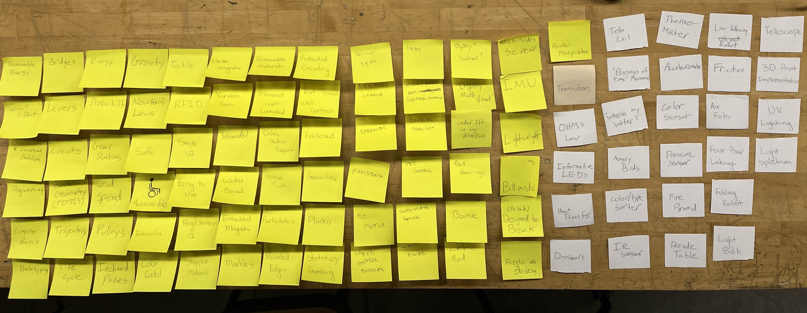
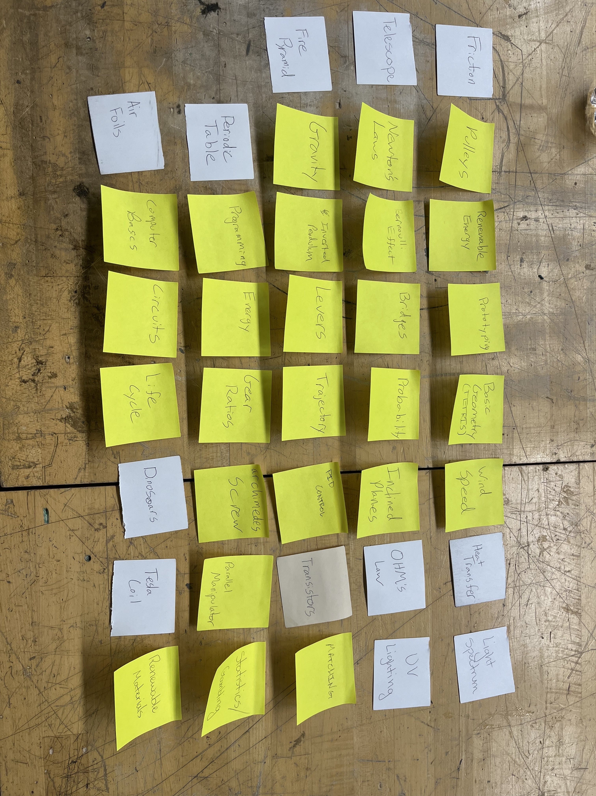
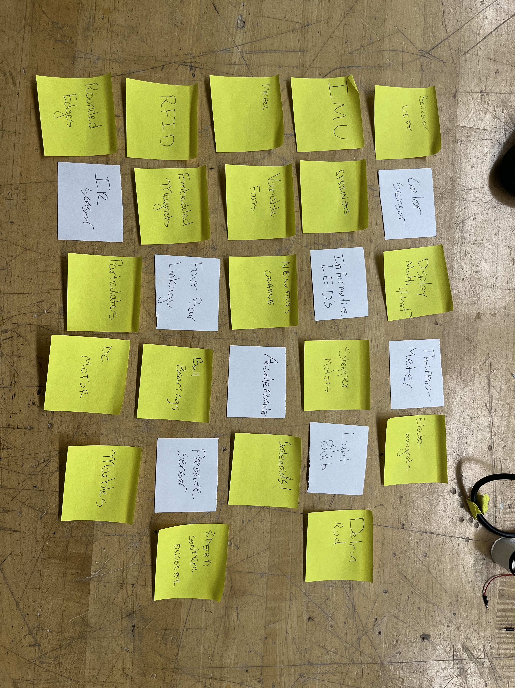
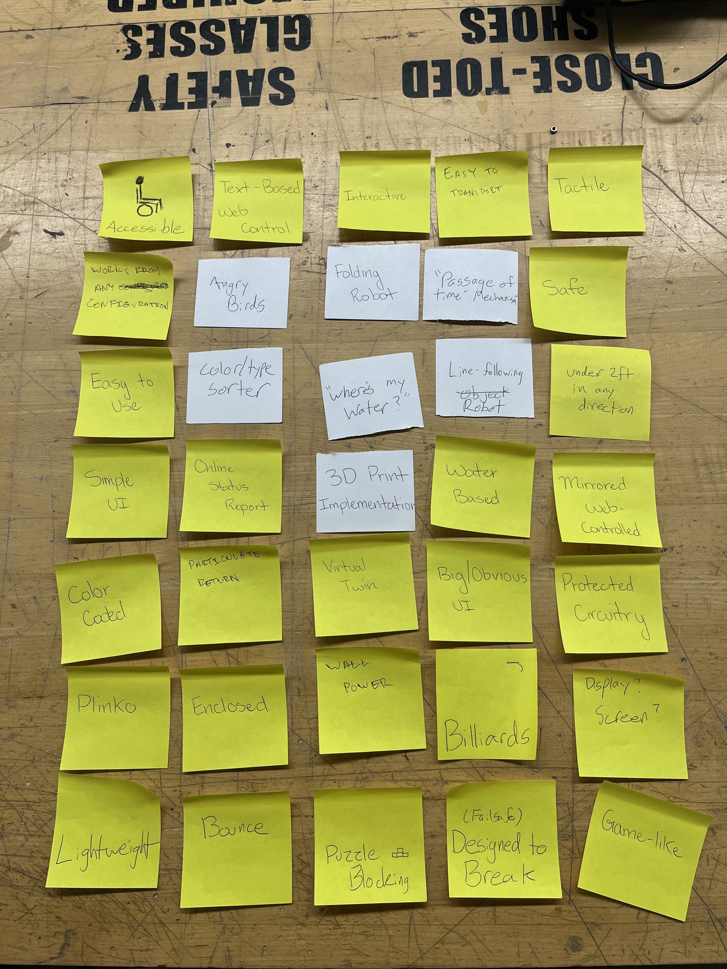
DESIGN IDEATION
BRAINSTORMING PROCESS
INITIAL BRAINSTORMING
CONCEPT ORGANIZATION
FINAL IDEA SELECTION
Speaker: JC R.
Notes:
JC

Slide 5
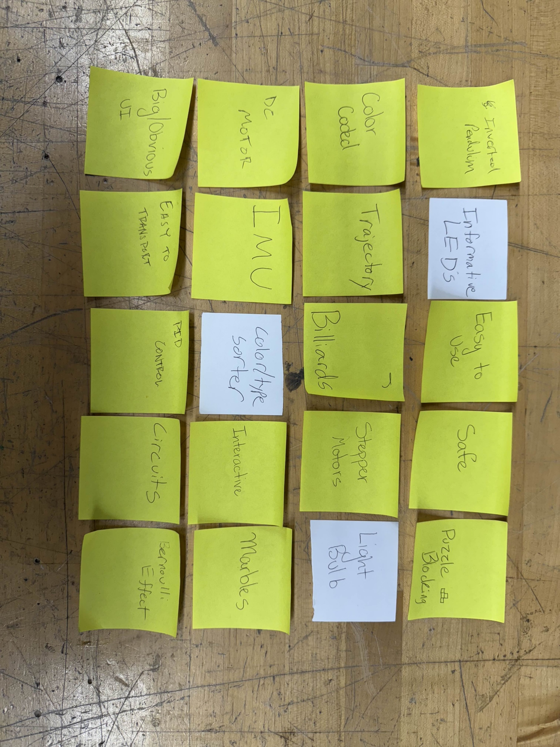
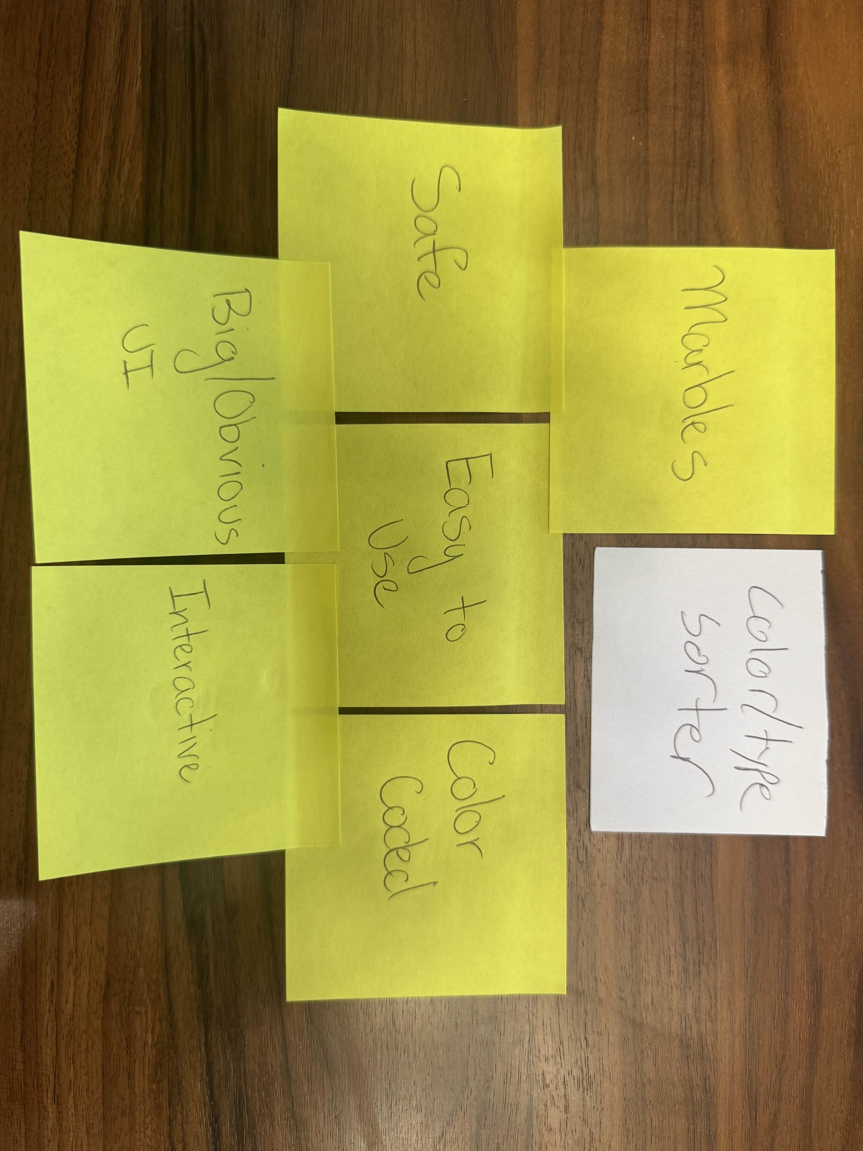
~ DESIGN IDEATION (cont.) ~
Speaker: JC R.
Notes:
JC

Slide 6
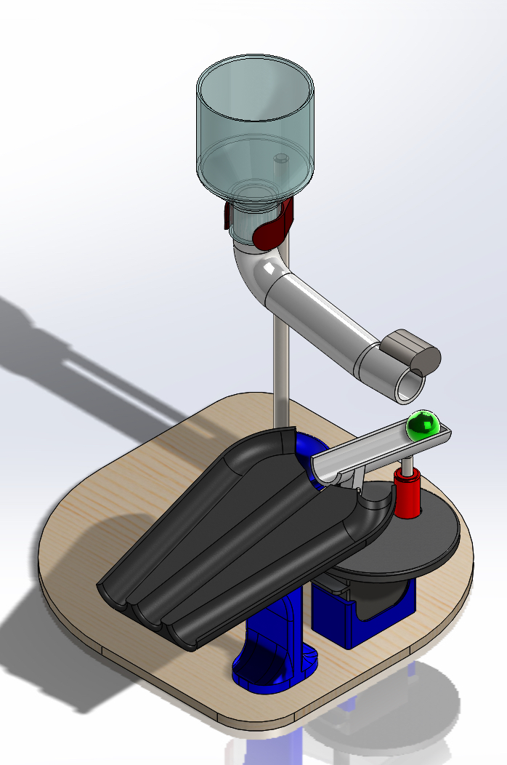
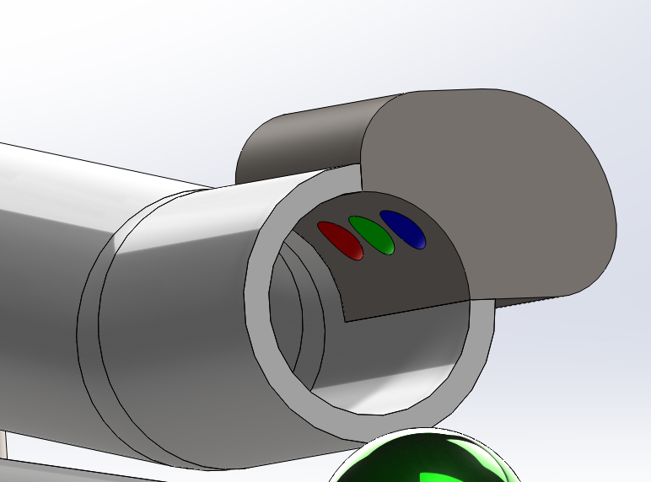
~ FINAL DESIGN CONCEPT ~
Color Sensor
Hopper w/ Marbles
Solenoid to engage ramp
3 Tracks for Sorting
Rotating plate
Speaker: Eric M.
Notes:
Eric

Slide 7
~ FINAL DESIGN CONCEPT (cont.) ~
USER INTERFACE & CONTROLS
Large, color-coded user interface
Buttons will share same color, order, and position of marble tracks for improved control
The exhibit will be constructed of plastics and polymers with rounded edges as well as an enclosure
Instructions will be printed in a clean, large font next to controls to be available to users at any time
Speaker: Eric M.
Notes:
Eric

